Slide 1
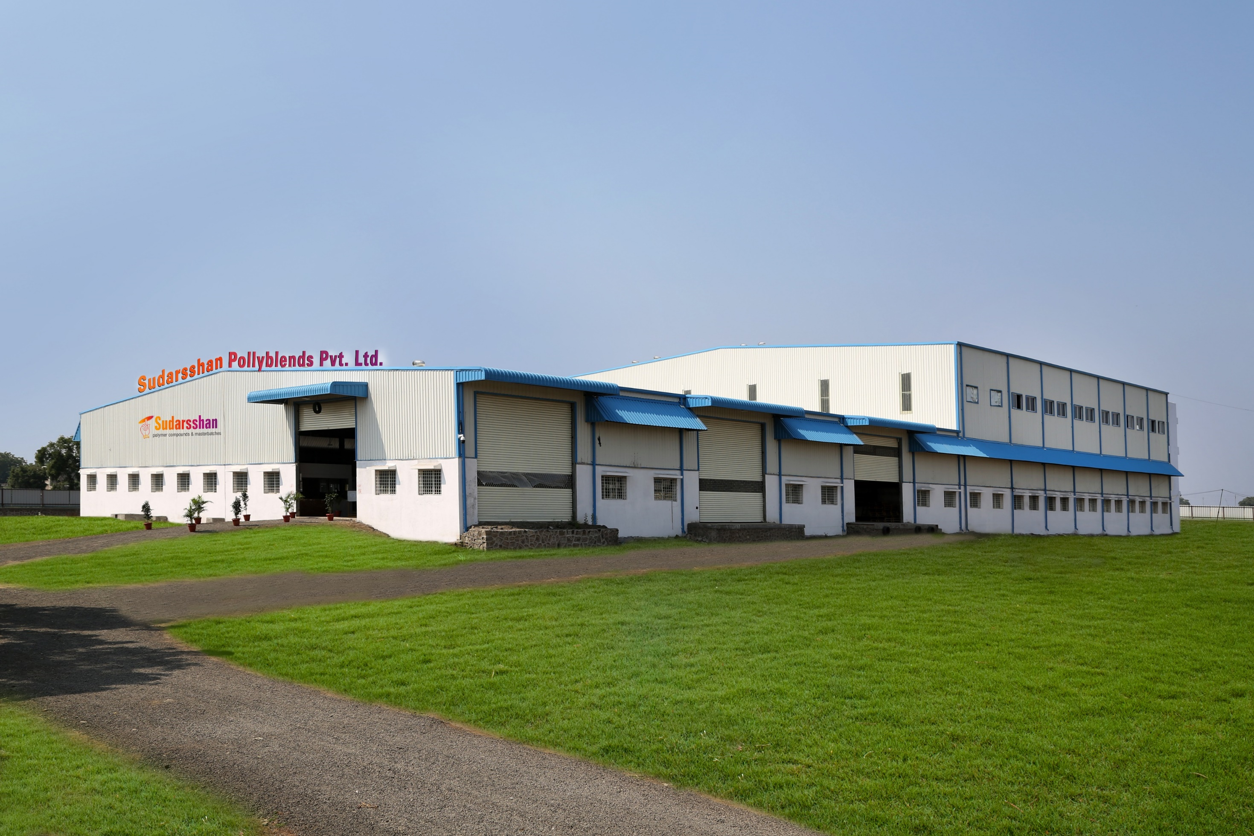
IATF 16949

Slide 2
Perfectly Engineered Polymers
At Sudarsshan you will always get polymers that are perfectly engineered for your product's unique characteristic needs - from its skin to soul...

Slide 3
SUDARSSHAN GROUP
Sudarsshan Pollyblends Pvt. Ltd.
Sudarsshan Pollyalloys
Sudarshan Plasst
IATF 16949

Slide 4
Growth Path
Sudarsshan has always been growth aspirant and has achieved consistent growth since the inception .
And now we are ready for an exponential growth.
1990
1997
2007
2017
2021
2025
Sudarsshan Group
Installed capacity of
10 KTA
Sudarsshan Group
Installed capacity of
24 KTA
Projected capacity of
48 KTA
Inception of
Sudarshan Plasst
Sudarsshan Masterbatches
Installed capacity of
1.2 KTA
Sudarsshan Pollyalloys Pvt. Ltd
Installed capacity of
6 KTA

Slide 5
Certifications

Slide 6
ISO
& IATF

Slide 7
UL

Slide 8
where manufacturing excellence
meets service excellence…

Slide 9
Combination of Skill & Scale
Experience
& Expertise
World Class
Facility
Latest Compounding
Technology
We have more than 20 years of experience in Polymer Industry
Most advanced Compounding facility of 24 KTA capacity
Automated Plant having advanced process controls
and team of experts who always love to take challenges and explore possibilities
expandable upto 48 KTA with currently built brick & mortar infrastructure
integrated with well equipped Quality Lab assuring repetitive product quality

Slide 10
Automated
Plant
Ensuring lowest human involvement
means lowest possibilities of human errors. Our automated plant has Auto Loading feeds for different types of raw materials. It has advanced sensors that consistently provide ideal conditions for polymer mixing, blending additives and other compounding additions.
Our setup ergonomics assures there is no chance for contamination in grades of products.

Slide 11
High accuracy automated conveying systems for ingredients like Talc & Calcium Carbonate to the nearest point of introduction.
Plant Features
Automated functions through advance equipments
Multiple feeding system for polymers maintaining the highest accuracy levels during weighing and mixing of ingredients.
Advanced control panel to control the process tolerances and critical parameters important for desired results.

Slide 12
For growing versatile needs
Our manufacturing setup is capable to cater polymers for diversified end products and processing techniques.
In today’s Global Scenario of ever expanding list of plastic products and their specific requirements, we can say we are future ready…
Our manufacturing lines can handle broad range of polymers and filled materials for different applications

Slide 13
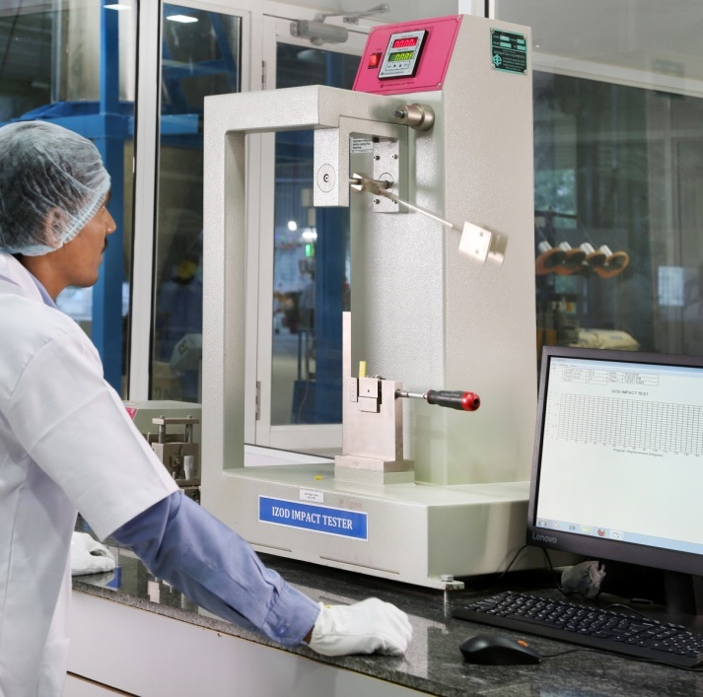
Highly Effective
Quality Management System
Usually all Quality Management Systems concentrate over 'Must Have' which is the minimum thing needed for survival. But in the today's competitive world to be a step ahead, Sudarsshan not just believes but practices - 'More Than Must Have‘…

Slide 14
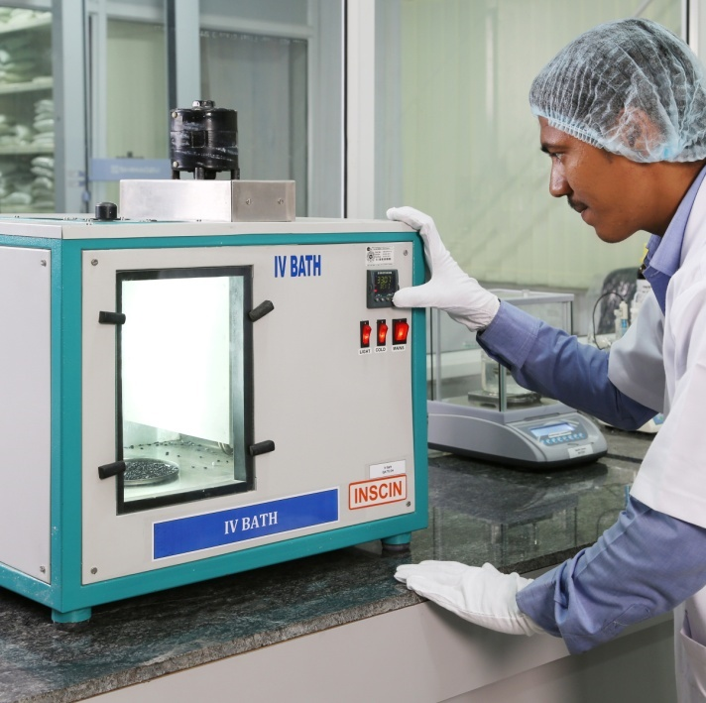
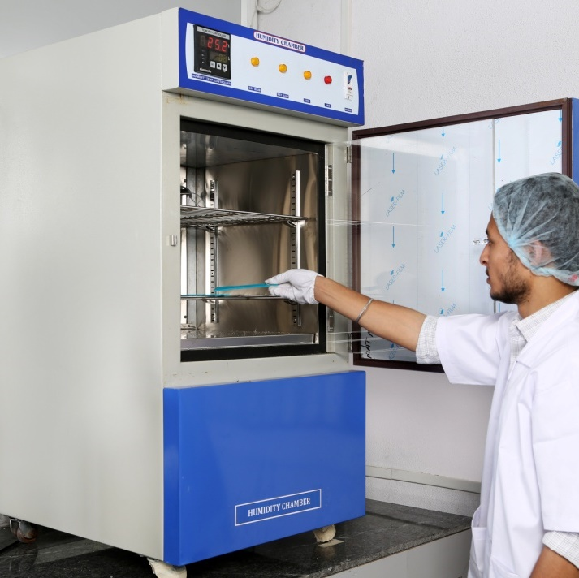
Testing Facilities
• IZOD Impact / Charpy Impact
• Tensile / Flexural
• MFI Testing
• Ash Content • Moisture Content • Colour Spectrometer • Carbon Content • HDT / VSP • Hardness Tester • Density
• Bulk Density
All quality tests are conducted as per ASTM & ISO standards

Slide 15
Sectors we serve

Slide 16
Sectors
Home Appliances
Automotive
Consumer Durables
Touching every sphere of life…
Packaging & Films
Electrical Appliances
Irrigation
And more…

Slide 17
Our Product Range

Slide 18
Polymer Compounds
You can count on us for advanced polymer materials as our compounds are nothing but engineered plastics.
Our Polymer Compounds
Enhancers
PP
PE
Nylon
ABS
HIPS
PC-ABS Alloy
PBT
Elastomers
Talc
Glass
Talc & Glass
CaCO3
FR
PP-EPDM
UV
BaSO4

Slide 19
Compounds customized to your needs
Along with standard polymer compounds we also serve customized polymers as per the need of your product.
We study the end product application, molding process, required properties and formulate the compound accordingly.
Properties like - scratch resistance, impact strength, super tough, high gloss, reinforcement, resilience etc… you name it and we can compound it for you.

Slide 20
Masterbatches
We deliver a full spectrum of Masterbatches to cater the needs of varied plastic processors.
Black Masterbatches The range includes grades from 30% upto 55% Carbon Black Loading. These grades are made out of best Carbon Black for best performance. Available in High Jet, Economy Black and Super Glossy Carbon black.
White Masterbatches The range includes grades that are from 35% upto 75% TiO2 Loading. Available in Milky, Ultra, High Ultra and Super white based on Optical brightener added grades.
Colour Masterbatches We have a range of Color Masterbatches. All batches are maintained within a close tolerance of dE 0.5. We also offer colours based on Pantone & RAL color codes.
Special Effect Masterbatches We offer Fluorescent, Pearl, Metallic, Glitter, Marble and much more.

Slide 21
Special Additive Masterbatches
We have a huge range of standard as well as customised Additive Masterbatches to improve your product’s characteristics and processing conditions as per your unique requirements.

Slide 22
Our range of Special Additive Masterbatches
Polymer Processing Aids
Anti Fog
Optical Brighteners
Anti Oxidant
Anti Corrosive
Anti Microbial
Flow Enhancer
UV
Desiccant
Designer

Slide 23
Colour Matching
No mater how unique colour you need, we will create it for you. Our proficiency in Colour Matching and updated technology help us create the exact colour in amazingly less time.
We maintain your Colour Library
We have facility of technical backup i.e. all the details of each masterbatch are stored, therewith assuring that you get your particular colour every time and any time.

Slide 24
Cost Innovation Solutions
We provide solutions for optimizing performance & cost of compounds while preserving the basic functionality & specifications.
Our experience & expertise helps us to design the perfect dynamics of cost and functions.
7
Engineering Plastics Replacement
Other Services
D A Y
Ut wisi enim ad minim veniam, quis nostrud exerci tation
Develop a compound from scratch
Reverse engineer a sample
Modify your existing formula for cost effectiveness
Engineering
Plastic
Metal
Other grades with Cost Innovation
Engineering Plastic
$19,99

Slide 25
Strategic Partnership Approach
Relationships based on trust and value creation
OEMs
Benefits for OEM’s
Benefits for Vendors
Quick response to OEM’s requirement
Providing Continuous Innovation possibility
Cost Innovation
Reduced Complexity
Customer Satisfaction
Purchasing efficiency – reduced complexity and broad product portfolio
Help and support in designing material formulation
Industry and regulatory compliance
Tier Vendors
Sudarsshan

Slide 26
Value Proposition Process
Application Development team (chemists, engineers and specialists)
Joint Development assisting Material
Selection
and Mold Designing
Joint Implementation
R&D
to
Execution
Detailed CTQs
Long term partnership
Well established A.D. Lab
Flexible and agile supply chain
services
Prototyping & Pilot Lots
for Validation

Slide 27
Environment Friendly
Approach
Clean Power-We have installed solar Panels of 820KV and currently using 25 % self generated power and planned to generate 70 % of our in- house demand. Which is max permissible limit.
We have complete rain water harvesting of our premised and uses our rain harvested water.
We do use recycled Polymers for compounding and have developed reliable sources.

Slide 28
Clients

Slide 29
Few of Our
Valued Clients

Slide 30
Google Map
Corporate Office:
Sudarsshan Pollyblends Pvt. Ltd.
Gut No. 295, Turkabad Kharadi Taluka Gangapur, Nagar Road, Aurangabad (Maharashtra) 431133, INDIA.
Contact Us
Sudarsshan Pollyalloys
Sector K, Plot no. 25, Waluj MIDC, Aurangabad - 431136 (MS), INDIA.
+91 8669940149
+91 8669940123
sales@sudarsshanpolly.com

Slide 31
THANKS

